Slide 1
Introduction to OSS - Azure
Mohd Mishal

Slide 2

About the Instructor
Microsoft Most Valuable Professional – Azure
C# Corner Most Valuable Professional
Microsoft Certified Trainer
7 Years of experience as Cloud Consultant
Azure – AWS – GCP – IoT – Machine Learning – Cognitive Services – Bot – Xamarin – Big Data
Consultant for Accenture, Adobe, Boeing, Deloitte., Infosys, Johnson Controls, Microsoft, Wipro, etc.,

Slide 3
Azure Datacenter
Opened first datacenter in 1989
Investment of more than $15 billion on infrastructure
Geo-replication over 500 miles apart
24x7 monitoring by US screened persons

Slide 4
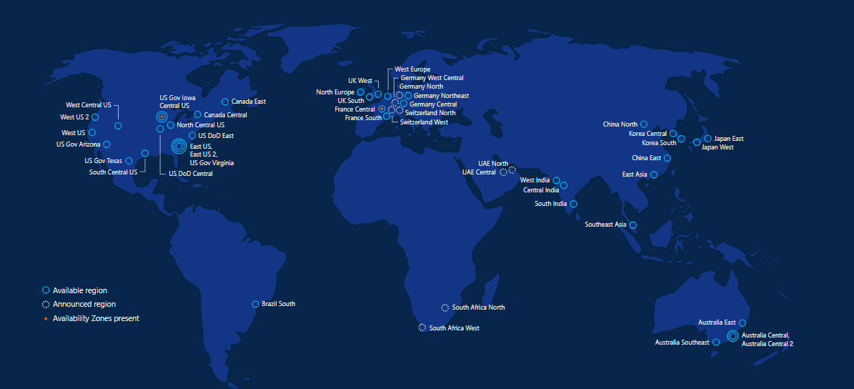
Azure regions – 50 Regions 140 Countries

Slide 5

Microsoft & Open Source

Slide 6

Inner Sourcing
In 2014, Microsoft CEO Satya Nadella directed all Microsoft engineers to "open source internally" - anyone at the company can see anyone else's code and use it as needed.
This vision is now a day-to-day reality for Microsoft engineers.
Notes:
Azure and Open Source – feedback from various UMICH departments is view that Azure is for “MSFT stack” and AWS is best for Open Source so need to emphasize our position on Open Source

Slide 7









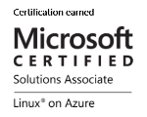
Microsoft + Open Source: Empowering Customers
Our Products
Our Offerings
Azure Marketplace
60% of all images in Azure Marketplace are based on Linux/OSS
SQL Server on Linux
Acquisition
Windows Subsystem for Linux
44% of VMs on Azure overall run Linux, and more than half of all new VMs run Linux
C:\Users\markhill> bash
44% / 1 in 3
HD Insight managed service on Linux
root@localhost: #
Run Linux on Windows natively
Our Partnerships
Our Employees
Ross Gardler President Apache SW Foundation
Brendan Burns
Co-Founder of Kubernetes
Partnership
Microsoft joins Eclipse Foundation
Partnership with the Linux Foundation for Linux on Azure certification
600 Million+
Lines of open source code
Partnership
Microsoft Open Source Hub
Jenkins project on Azure
Notes:
Notes coming soon – please check back on http://aka.ms/opensource for latest version

Slide 8












































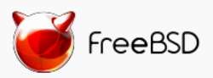

Azure is an open cloud
DevOps
Clients
Management
Applications
PaaS &
DevOps
App Frameworks
& Tools
Databases &
Middleware
Infrastructure
Notes:
P2

Slide 9
Why Linux on Azure
Our customers want it!
Roughly 1 out of 3 VMs run Linux & OSS
Enterprise grade cloud leadership
Only true hybrid cloud
Our goal is to be the most complete and open cloud

Slide 10







Linux images in the Azure Marketplace
Public Cloud
Azure Endorsed Linux Distributions
Published, maintained and supported by partners, curated & tested by Microsoft
Most endorsed distros maintain repos in each Azure region for fast updating
Standard Images
Customers can contact Linux vendor/partner for Linux support
Azure-related platform issues supported by Microsoft
Limited support for Linux issues -- from Microsoft
Premium Images
Microsoft engages the Linux vendor/partner on behalf of the customer for support
Includes updates, patches, and support through 24x7 web, email, chat and phone
Available for Red Hat Enterprise Linux and SUSE Linux Enterprise Server
Red Hat
Enterprise Linux
CoreOS
Ubuntu
OpenLogic
CentOS-based
SUSE Linux
Enterprise
Server
openSUSE
Oracle
Linux

Slide 11
Linux Distributions on Azure
CentOS
CoreOS
Debian
Oracle Linux
Red Hat Enterprise Linux
SUSE Linux Enterprise
openSUSE
Ubuntu

Slide 12
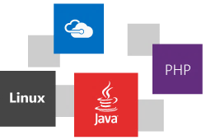

Slide 13
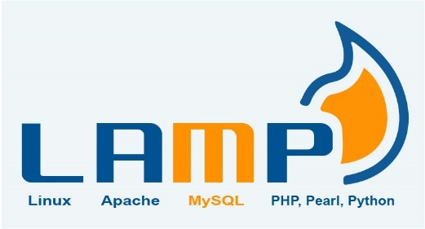

LAMP → Azure
Create an Ubuntu VM (the 'L' in the LAMP stack)
Open port 80 for web traffic
Install Apache, MySQL, and PHP
Verify installation and configuration

Slide 14
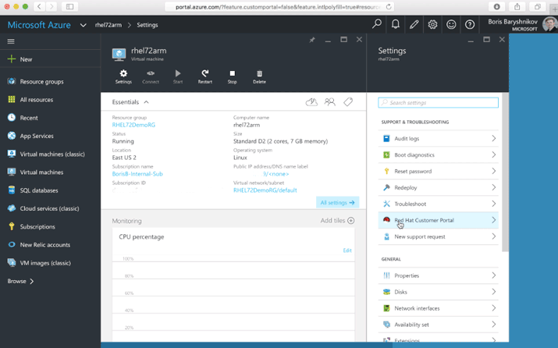
Accessing the Red Hat Customer Portal from Azure
With Azure “Pay As You Go” licensing, you can connect your subscription to Red Hat to access all Red Hat premium content and support.
Customers with existing Red Hat subscriptions may also seamlessly extend those to Azure using Red Hat Cloud Access
https://azure.microsoft.com/en-us/blog/red-hat-customer-portal-from-azure/
https://www.redhat.com/en/technologies/cloud-computing/cloud-access

Slide 15
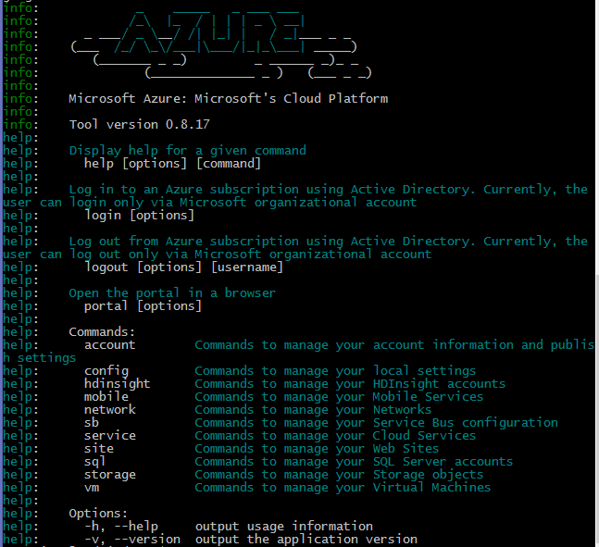
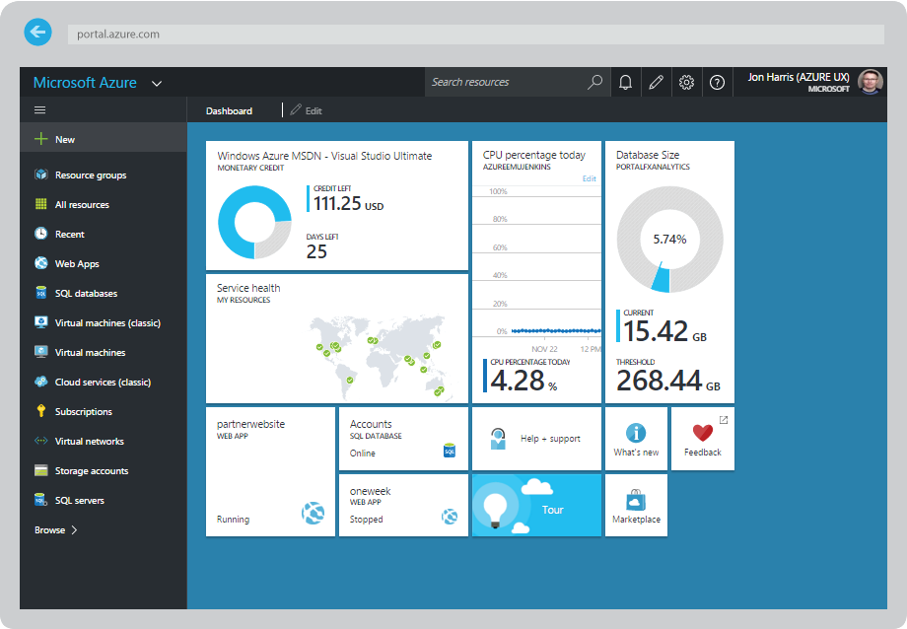
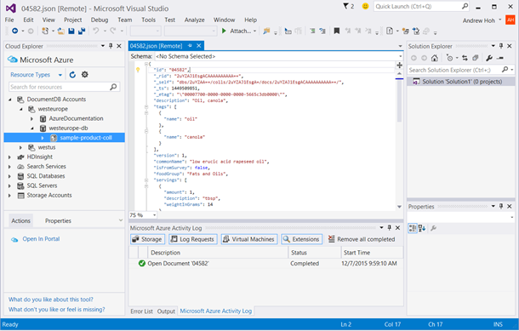
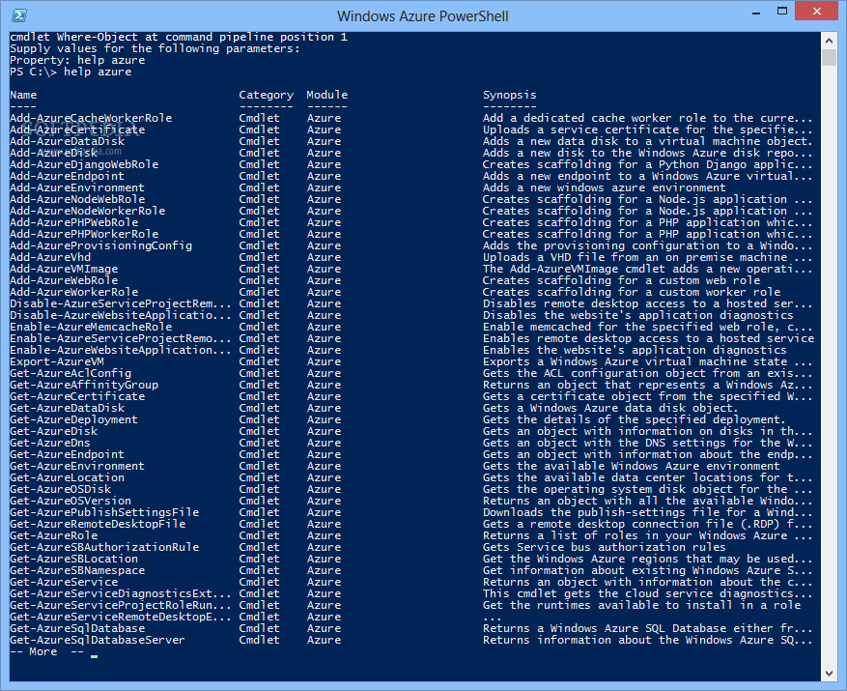

CLI, Portal, PowerShell, Visual Studio
Multiple ways to interact with Azure for any enterprise!
http://portal.azure.com
Linux Azure CLI Interface
http://aka.ms/azure-cli-2

Slide 16
Compute: IaaS, PaaS & Mobile Services

Slide 17
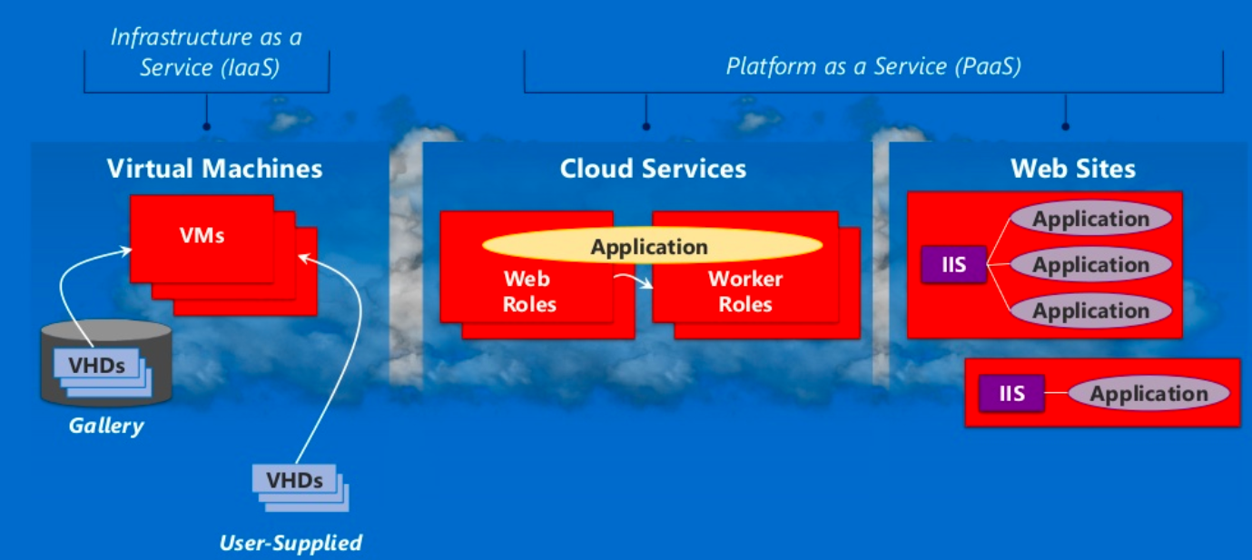
Azure Compute:

Slide 18
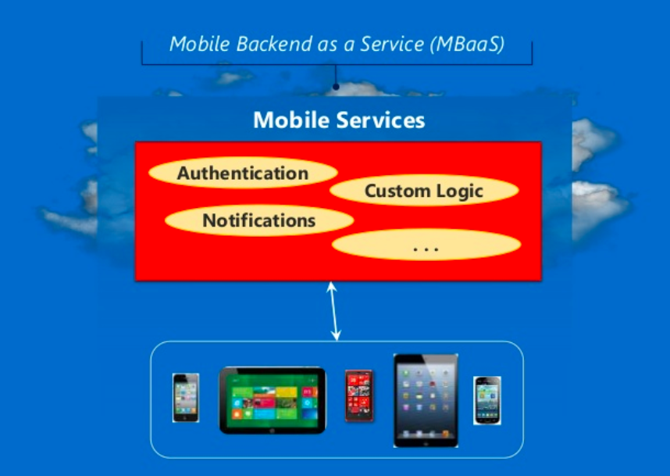
Azure Compute:

Slide 19
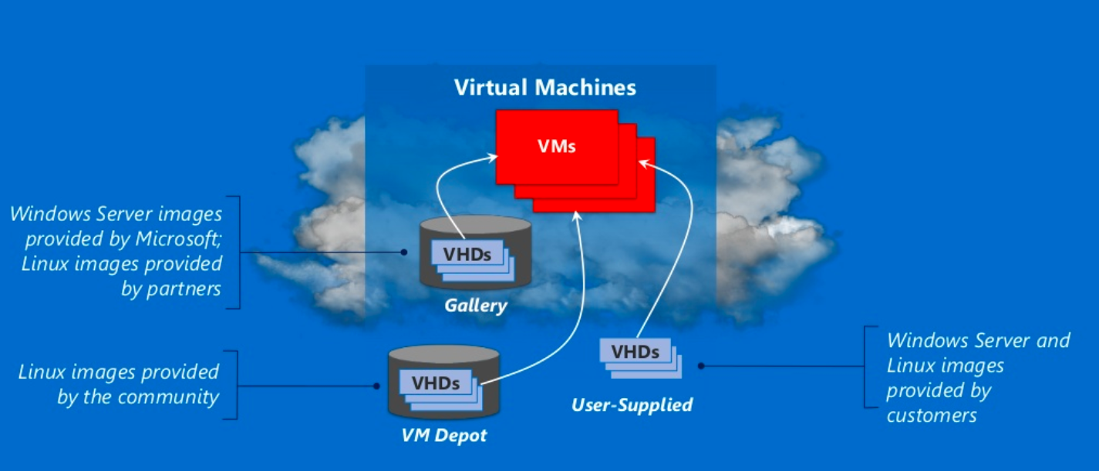
Azure Compute : IaaS

Slide 20
Linux Images:
Canonical UBUNTU
Oracle Linux
SUSE Linux Enterprise
OpenSUSE Linux
CENTOS by Open Logic
Notes:
Microsoft provides forum based support for all open source platforms today
Canonical Ubuntu – also available with pre-installed puppet enterprise from puppet labs.

Slide 21
Management with Puppet and Chef
Windows VM's
Linux VM's
Puppet Console
Chef Management Console

Slide 22
Linux images on Azure
Linux distributions
Images also includes other software
Notes:
The Linux images in the gallery just provides the OS
Linux distributions on other platforms like Debian are also available on azure.
Images also includes other softwares like wordpress

Slide 23
Pricing Comparison
Windows Server
Linux Server
Small A1 (1 Core, 1.75 GB) | $0.09 per hour
Medium A2 (2 Cores, 3.5 GB) | $0.18 per hour
Large A3 (4 Cores, 7 GB) | $0.36 per hour
Extra Large A4 (8 Cores, 14 GB) | $0.72 per hour
Memory Intensive A5 (2 Cores, 14 GB) | $0.33 per hour
Memory Intensive A6 (4 Cores, 28 GB) | $0.66 per hour
Memory Intensive A7 (8 Cores, 56 GB) | $1.32 per hour
Small A1 (1 Core, 1.75 GB) | $0.06 per hour
Medium A2 (2 Cores, 3.5 GB) | $0.12 per hour
Large A3 (4 Cores, 7 GB) | $0.24 per hour
Extra Large A4 (8 Cores, 14 GB) | $0.48 per hour
Memory Intensive A5 (2 Cores, 14 GB) | $0.25 per hour
Memory Intensive A6 (4 Cores, 28 GB) | $0.50 per hour
Memory Intensive A7 (8 Cores, 56 GB) | $1.00 per hour
Notes:
Standard pay as you go pricing
Linux is as much as 1/3 cheaper than windows server

Slide 24
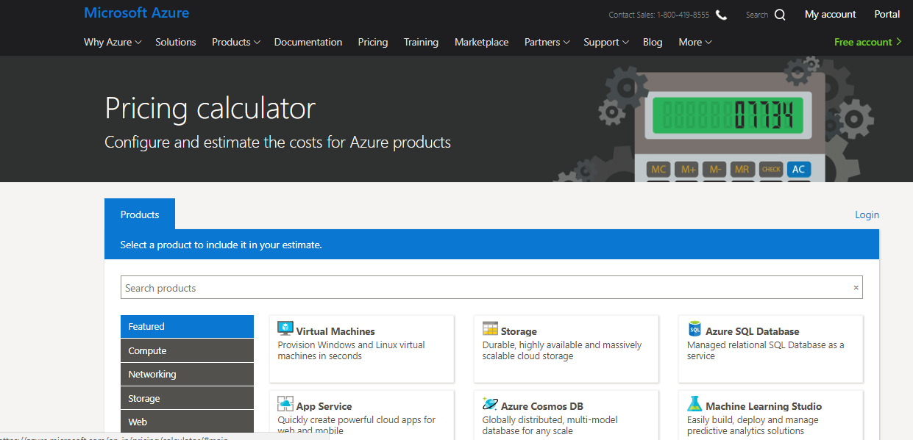
Demo

Slide 25
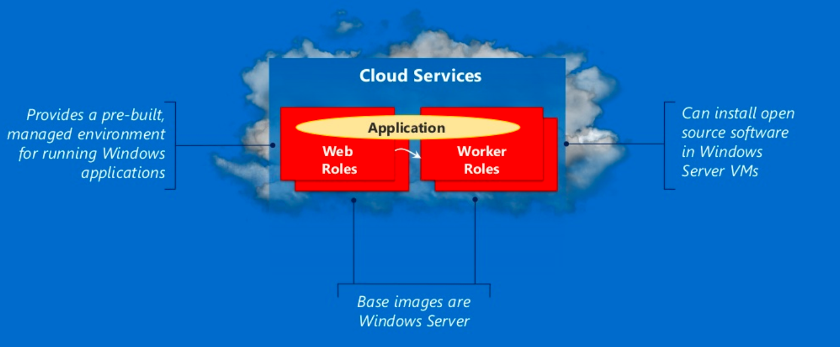
Azure Compute : PaaS

Slide 26
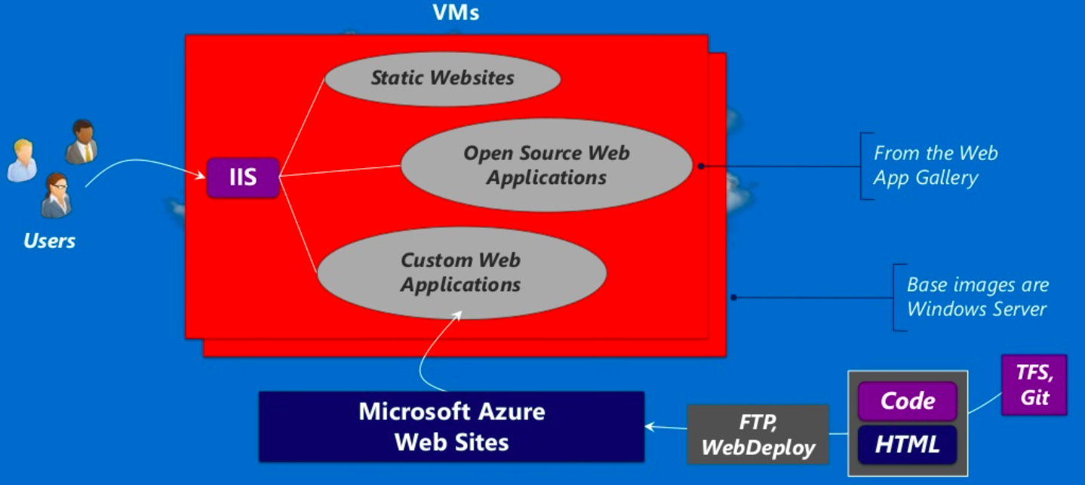
Azure Compute – PaaS - WebApps

Slide 27



Azure Web Sites:
Applications | What it provides | Technology Foundation
Wordpress | Content Management System and Blogging | PHP/MySQL
Joomla | Content Management System | PHP/MySQL (and others)
Media Wiki | Wiki package | PHP/MySQL (and others)
Apache Tomcat | Web Server (or) Servlet Container | Java
Express | Web Framework | Javascript / Node.js

Slide 28


Supported Open Source Web Developments
Node.js
.
.
Notes:
PHP – Scripting language and environment for web development
Node.js - environment for web development with javascript
Python – general purpose dynamic programming language.
Note - .net and java applications are also supported.

Slide 29
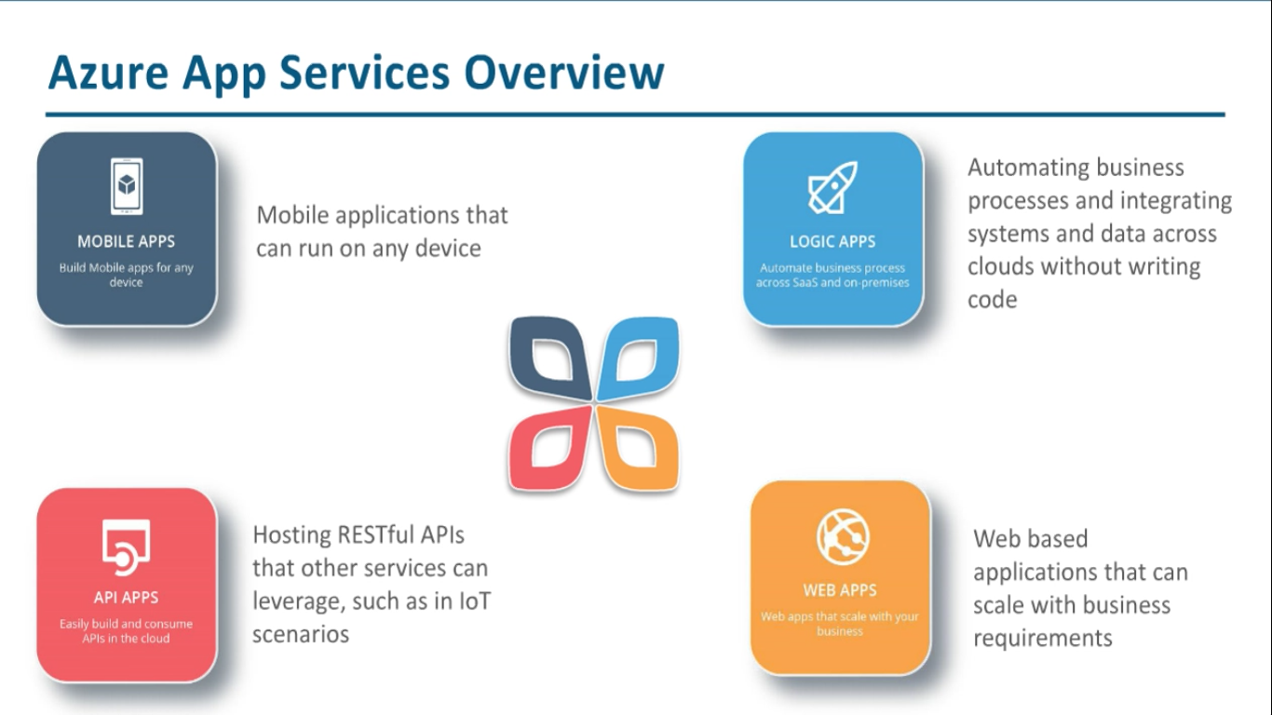

Slide 30
Data
SQL
NoSQL
Big Data Analytics

Slide 31
Azure with Open Source:
 | Operational Data | Analytical Data
NoSQL Technologies | Tables, Redis Cache Cassandra, HBase, etc., MongoDB Neo4J, etc., | Big Data Analytics – HDInsight, Hadoop
SQL Technologies | SQL Database, SQL Server, Oracle, MySQL, etc., | Relational Reporting & Relational Analytics
Notes:
Provided by Microsoft Azure – Runs in MS Azure VM's – Runs in MS Azure Virtual Machines and its open source

Slide 32
Operational NoSQL Databases
Example Technologies | What it provides?? | Example Use Cases
Redis – Azure Tables | Fast access to large amounts of simply structured data | Online shopping cart
Cassandra, HBase | Fast access to large amounts of more structured data | A table storing web pages
MongoDB | Scalable store for JSON documents | Persistent store for Node.js application
Notes:
Provided by Microsoft Azure – Runs in MS Azure VM's – Runs in MS Azure Virtual Machines and its open source

Slide 33

LFCS Preparation Training Session I: The history of Linux & Why do we care: How OSS drives Azure consumption
Stuart R. Kirk, MCSA: Linux On Azure, RHCA
Technology Solutions Professional
Global Black Belt Team – Open Source Azure Incubation

Slide 34
Session I Agenda
Much of the data in this first session will not be tested upon
This session aims to provide the following:
A brief history of Linux
An understanding of core Linux terms which will be used in all sessions
Guidance to set up your personal test environment
Why Open Source is essential to increasing consumption on Azure
The test environment is essential to building upon the skills taught in subsequent sessions of this program

Slide 35


History of UNIX/Linux
UNIX was conceived by Ken Thompson and Dennis Ritchie from AT&T Bell Labs in 1969
Common UNIX derivatives include: SCO, IRIX, Solaris, AIX, HP/UX, BSD
Linux was created by Finnish software engineer Linus Torvalds in 1991
Made from a collection of open source software based on the Linux kernel which Torvalds developed
Linux is driven by community contributions which are merged into upstream “projects” and provided to users. Features are created based on need.

Slide 36
Common OSS/Linux Terms
Kernel – The core of the Linux operating system
Distribution (Distro) – A variant of the Linux operating system
Command-Line/Shell – The terminal window which commands are executed within
Daemon – A running service on a Linux server, httpd would be the web server
X-Windows (or X) – A graphical user interface to interact with & run applications
RPM – A package manager that provides for the install / removal / tracking of software
Fork – When a distribution is duplicated and changed to produce a new distribution
Package – An archive of software; Most apps on a host are installed via packages
GNU – Acronym for GNU’s Not Unix
GPL – The GNU GPL, or General Public License, is a free software license which guarantees end users the freedom to run, study, share and modify software
SSH – Secure Shell – Allows connections to other Linux servers via an encrypted tunnel

Slide 37

Distributions are a lot like Genealogy
Hundreds of distributions
https://en.wikipedia.org/wiki/List_of_Linux_distributions
Linux builds are based on a number of “Major” distributions
Debian (Knoppix, CentOS, Android, Linux Mint, Raspbian)
Gentoo (Chromium OS, CoreOS)
Pacman (Arch Linux)
RPM (Red Hat Linux, Red Hat Enterprise Linux, Fedora, Caldera, Oracle Linux)
Slackware (SuSE, Frugalware,
TUX the penguin got his name from “Torvalds’ UniX”

Slide 38
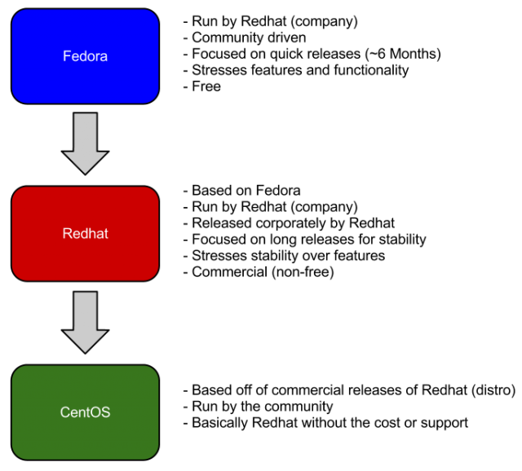
Commercial vs Community
Community projects have very quick release cycles
Typically bleeding edge technology and what will be seen in future commercial releases
Application vendors are unable to create software certified against a community project
Enterprise Linux products have much longer release cycle
Users pay for the support; Not the software

Slide 39
Red Hat Enterprise Linux forks from Fedora (Core)
Release | Codename | Release Date | Based on
Red Hat Linux 6.2E | Zoot | 2000-03-27 | Red Hat Linux 6.2
Red Hat Enterprise Linux 2.1 | Pensacola (AS)/ Panama (ES) | 2002-03-26 (AS) | Red Hat Linux 7.2
Red Hat Enterprise Linux 3 | Taroon | 2003-10-22 | Red Hat Linux 9
Red Hat Enterprise Linux 4 | Nahant | 2005-02-15 | Fedora Core 3
Red Hat Enterprise Linux 5 | Tikanga | 2007-03-14 | Fedora Core 6
Red Hat Enterprise Linux 6 | Santiago | 2010-11-10 | Mix of Fedora 12 Fedora 13 and several modifications
Red Hat Enterprise Linux 7 | Maipo | 2014-06-10 | Primarily Fedora 19 with several changes from 20 and later

Slide 40
What is / isn’t Open Source ?
Open Source
Source code freely available
Contributions can be made to the source code and submitted “upstream”
Distributed under licenses such as LGPL, GNU, MIT, etc.
Many licenses exist with varying degrees of restrictions.
Typically more secure due to community contributions
Closed Source
Source code not available
Software development is at the discretion of the application vendor
Software is copyrighted and licenses prohibit distribution
Software patches typically longer to distribute
Typically more profitable for vendors
https://opensource.org/licenses

Slide 41

What is ‘root’ ?
The ‘root’ user on any Linux system is used for administering the system
Equal to Windows “Administrator” account
Has complete access to the system, user home directories, service control, priorities, software managers, mail, etc.
Due to the “power” present in the “root” account, most Linux system administrators only use it to make necessary changes to a system that require elevated privileges
Administrators will typically create a login for themselves, for example, “bob” and when they require elevated permissions will “substitute user” or “su” to the root account, perform necessary actions, and then resume their original login shell

Slide 42
Pre-Requisites for Training Sessions
An RPM-based Linux virtual machine hosted locally or on Azure
Windows 10
Login to your Azure Account
Install the Azure CLI on CentOS
Install Windows 10 Subsystem for Linux
Install CentOS from App Store
Create a CentOS VM using the Azure CLI
Login to your Azure Account
Install the Azure CLI in Windows 10 Bash
Login to the CentOS VM using SSH
Shut Down your CentOS VM when finished

Slide 43
Installing the Windows 10 Subsystem for Linux
In Windows 10 enable developer mode
“Cortana” => “developer” => “For Developers Settings” => “Developer Mode”
Enable the Windows Subsystem for Linux
“Control Panel” => “Programs and Features” => “Windows System for Linux”
Reboot host and allow updates to be installed
Install CentOS from the App Store
Run CentOS shell.
Create a Linux Username
Create a Linux Password
Requires Windows 10 Anniversary Edition

Slide 44
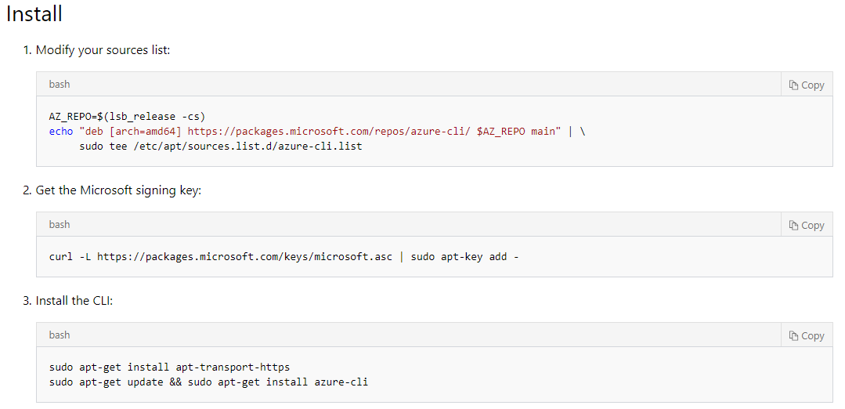
Installing the Azure CLI on Windows 10 Bash for Windows
Log in to the Windows Bash Shell
Execute-as-root (or ‘sudo’) to the root account
For new VM installs on Azure, root access is obtained by typing “sudo su - root”
Verify your configuration:
az login
https://docs.microsoft.com/en-us/cli/azure/install-azure-cli-apt?view=azure-cli-latest

Slide 45
Creating a CentOS VM using Cloud-Shell in Azure Portal
Create and Start the Virtual Machine
az group create -n lfcs -l eastus2 -o table
az vm create -g lfcs -n lfcs --image OpenLogic:CentOS-LVM:7-LVM:7.5.20180524 --authentication-type password --storage-sku Standard_LRS --size Standard_A3 --admin-username mohd -o table

Slide 46
Installing the Azure CLI on CentOS Linux
SSH connect to your CentOS VM from the Windows 10 bash shell
ssh USERNAME@publicIP
Accept the initial SSH key exchange warning
Substitute user (or ‘su’) to the root account
For new VM installs on Azure, root access is obtained by typing “sudo su - root” & entering the password you used when you created the VM
Install Azure CLI:
Verify your configuration:
az help

Slide 47
Shut down your CentOS VM when it isn’t in use!
The CentOS virtual machine created makes use of the CentOS Pay-As-You-Go VM image in the Azure Marketplace. In order to avoid large consumption charges, shut it down when it is not in use.
To stop the Azure CentOS VM from the Windows 10 bash shell:
az vm stop -–resource-group LinuxLFCSPrep -–name CentOSDemo
az vm deallocate -–resource-group LinuxLFCSPrep -–name CentOSDemo (You will lose your public IP address!)
To start the Azure CentOS VM from the Windows 10 bash shell:
az vm start -–resource-group LinuxLFCSPrep -–name CentOSDemo
az vm list-ip-address (Because deallocating the VM removed the public IP, this will determine the new IP)
To delete the Azure RHEL VM from the Windows 10 bash shell:
az vm delete -–resource-group LinuxLFCSPrep -–name CentOSDemo
azure group delete LinuxLFCSPrep

Slide 48
Final Thoughts
There are many ways to perform tasks in Linux
The LFCS exam, and most performance based exams, measure the ability to configure the Linux host as required
The exam does not measure *how* to get to your end result
Very binary – Is the task completed / Does the service work, or not?
Never hard code; Variables are your friend

Slide 49
LFCS Preparation Training Session II: Linux Unveiled! What is BASH?
Stuart R. Kirk, MCSA: Linux On Azure, RHCA
Technology Solutions Professional
Global Black Belt Team – Open Source Azure Incubation

Slide 50
Session II Agenda
What is BASH? What is a shell?
Overview of basic commands
Comparing MS-DOS and Linux commands
Linux Permissions
The Linux kernel
Navigating the Linux file system and device/system directories
Important file locations
An overview of the RPM Package Manager

Slide 51
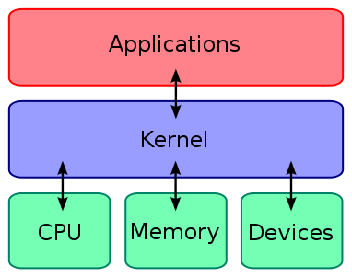
The Linux Kernel
The nucleus of the operating system
Has absolute control over everything that occurs on the system
Created in 1991 by Linus Torvalds
Highly tunable based on application / user needs
Tunable parameters are set statically inside /etc/sysctl.conf
Dynamic tunables can be set within the /sys and /proc system directories

Slide 52
The Linux Shell
Allows you to interact with the operating system
Always text-based
Default result of “telnet/ssh”
Can be invoked through an X-Window GUI; Usually called “Terminal”
A typical user’s shell prompt:
[stkirk@stkirk-fedora ~]$ (The $ represents a normal user)
A root user’s shell prompt:
[root@stkirk-fedora ~]# (The # represents the root user)

Slide 53
Variants of Shells
sh (Bourne Shell)
ksh (Korn Shell)
csh (C-Shell)
bash (Bourne Again SHell – Combines ksh and csh – Default)
tcsh (T-C-Shell)
zsh (Z-Shell)
If you wish you change your shell, you may do so using the `chsh` command.

Slide 54
Keyboard/Command Line Shortcuts
<Tab><Tab> Attempt Autocomplete
Control + D Logs out of the current session
Control + H Erases one character (backspace)
Control + U Erases the current line
Control + W Delete the last word typed
cd ~ Return to your home directory
reset Resets the terminal if not displaying correctly
poweroff Shut down the VM & Power off the host

Slide 55
Overview of Basic Commands
cp Copy a file
mv Move / Rename a file or directory
nano A TUI-based editor similar to “edit” / other options – vi / emacs
grep A very useful pattern matching tool
cut Remove sections from files based on fields and delimiters
sort Sort lines of a text file
sed Stream Editor – Perform transformations to text / files
awk Pattern scanning and processing language
uniq Report or omit duplicate lines while parsing a file
wc Word Count – Show the number of words / chars / lines in a file

Slide 56
Streams, Pipes & Redirects
> Create New
cat /etc/passwd > ~/myfile
more ~/myfile
>> Append
cat /etc/bashrc >> ~/myfile
more ~/myfile
| Pipe output through multiple commands
cat ~/myfile | tr [a-z] [A-Z]

Slide 57
Overview of Basic Commands (continued)
whoami Print the username effective with the current user ID
echo Display a line of text
cat Catalogue / Concatenate a file – display / join files
ssh Secure Shell -
logout Log off of the current session
su Substitute User – Inherit another user’s ID & properties
sudo Execute a command as another user
man A user interface to online reference manuals
mdadm Manage Linux software RAID devices
yum Yellowdog Updater Modified – An RPM package manager
* yum is being replaced by “dnf” – Dandified Yum

Slide 58
Overview of Basic Commands (continued)
ln Create hard / symbolic links (similar to shortcuts)
pvcreate Create an LVM Physical Volume
vgcreate Create an LVM Volume Group
lvcreate Create an LVM Logical Volume
mkfs Make a filesystem – Equal to formatting a disk
mount Mount a Linux filesystem so it is available to a running host
umount Unmount a Linux filesystem from a host
ps View running system processes
top View current system utilization
mtr My (Matt’s) Traceroute – A combination of ping and traceroute

Slide 59

Overview of Basic Commands (continued)
touch Change file timestamps – Also used for creating empty files
kill Kill (stop) a running process
systemctl Manipulate systemd services
Services on RHEL 7.x are managed by
Systemd which is the successor to
SysVinit. The `systemctl` command can
be used to start/stop/enable/disable/
reload services. For those familiar with
Linux “runlevels”, these are replaced by
“targets”.

Slide 60
DOS to Linux “Cheat Sheet”
Command's Purpose | MS-DOS | Linux | Basic Linux Example
Copies files | copy | cp | cp thisfile.txt /home/thisdirectory
Moves files | move | mv | mv thisfile.txt /home/thisdirectory
Lists files | dir | ls | ls
Clears screen | cls | clear | clear
Closes prompt window | exit | exit | exit
Displays or sets date | date | date | date
Deletes files | del | rm | rm thisfile.txt
Echoes output on the screen | echo | echo | echo this message
Edits files with simple text editor | edit <file> | nano <file> | nano thisfile.txt
Compares the contents of files | fc | diff | diff file1 file2
Finds a string of text in a file | find | grep | grep this word or phrase thisfile.txt
Formats a floppy | format | mkfs | /sbin/mke2fs /dev/fd0 (/dev/fd0 is the Linux equivalent of A:)
Displays command help | <command> /? | man <command> | man command
Creates a directory | mkdir | mkdir | mkdir directory (Consider using –p to create a directory tree)
Screens through a file | more | more (or less) | less thisfile.txt
Renames a file | ren | mv | mv thisfile.txt thatfile.txt[e]
Shows your location in the file system | chdir (cd) | pwd | pwd
Changes directories with a specified path (absolute path) | cd \pathname | cd /pathname | cd /directory1/directory2
Changes directories with a relative path | cd .. | cd .. | cd ..
Displays the time | time | date | date
Shows amount of RAM and use | mem | free | procinfo

Slide 61
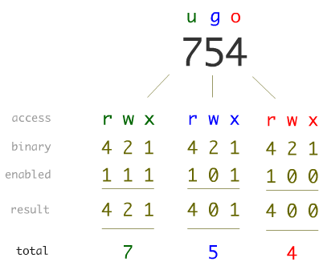
Linux Permissions
Basic Linux permissions broken up into 3 permissions groups: user, group, others
Permissions can be set in each group for read, write, execute
Permissions manipulated with the `chmod` command.
Can be set using binary references or explicitly:
chmod u+x foo.txt; chmod g+r foo.txt
chmod 644 foo.txt
---------- /etc/shadow
-r--r----- /etc/sudoers
-r--r--r-- /etc/machine-id
-rw------- /etc/crypttab
-rw-r----- /etc/brlapi.key
-rw-r----- /etc/chrony.keys
-rw-r--r-- /etc/chrony.conf
-rw-r--r-- /etc/cron.deny
-rw-rw-r-- /etc/fstab
-rw-rw-r-- /etc/hostname
-rwx--x--x /usr/bin/testapp

Slide 62
The Linux File System
/bin This directory contains executable programs which are needed in single user mode and to bring the system up or repair it.
/sbin Like /bin, this directory holds commands needed to boot the system, but which are usually not executed by normal users.
/usr/bin This is the primary directory for executable programs. Most programs executed by normal users which are not needed for booting or for repairing the system and which are not installed locally should be placed in this directory.
/usr/local This is where programs which are local to the site typically go.
/usr/local/bin Binaries for programs local to the site.
/usr/local/sbin Locally installed programs for system administration.
[stkirk@stkirk-fedora /]$ tree -L 1 -d
.
├── bin -> usr/bin
├── boot
├── dev
├── etc
├── home
├── home2
├── lib -> usr/lib
├── lib64 -> usr/lib64
├── lost+found
├── media
├── mnt
├── opt
├── proc
├── root
├── run
├── sbin -> usr/sbin
├── srv
├── sys
├── tmp
├── usr
└── var
21 directories

Slide 63
The Linux File System
[stkirk@stkirk-fedora /]$ tree -L 1 -d
.
├── bin -> usr/bin
├── boot
├── dev
├── etc
├── home
├── home2
├── lib -> usr/lib
├── lib64 -> usr/lib64
├── lost+found
├── media
├── mnt
├── opt
├── proc
├── root
├── run
├── sbin -> usr/sbin
├── srv
├── sys
├── tmp
├── usr
└── var
21 directories
/boot Contains the grub and kernel core files
/dev Host generated devices directory
/etc Pronounced “et-see” holds config files
/home User home directories
/root Home directory for the root user
/tmp A temporary scratch area writable by all
/var Typically holds log files and files written during application runtime, for example a DHCP leases file

Slide 64
Filesystem “Cheat Sheet”
Directory | MS-DOS | Linux
Root Directory | C:\ | /
User’s Home Directories | C:\Users | /home
Temporary Scratch Space (writable by all) | C:\Temp | /tmp
User-installed local applications | C:\Program Files | /usr/local/bin
Core system files | C:\Windows | /usr/bin or /bin
Core system files | C:\Windows\System32 | /usr/sbin or /sbin

Slide 65
Important File Locations
/etc/fstab (F) List of file systems to be mounted
/etc/sysctl.conf (F) Kernel tuning parameters
/etc/sysconfig/network-scripts (D) Location of network interface configs
/etc/hostname (F) The system hostname set via `hostname`
/etc/httpd/conf/httpd.conf (F) Configuration for the web server
/etc/defualt/grub (F) Bootloader configuration
/dev/null (F) The “black hole”
/etc/group (F) System groups file
/etc/passwd (F) User password file, minus passwords
/etc/shadow (F) Encrypted password file

Slide 66

Important File Locations
/etc/issue (F) Contains text that is displayed prior to user login
/etc/resolv.conf (F) DNS Servers and searchable domains stored
/proc/cpuinfo (*) Information on the current recognized CPUs
/proc/meminfo (*) Information on current memory usage
/etc/skel (D) Files that are copied into a new user’s home directory upon creation of an account.

Slide 67
“Man” is Your Friend
An interface to view reference manuals
Invaluable source of documentation
Most provide real working examples – Answers to your test questions!
“Man” pages are organized by “Sections”
Will, by default, search in “Section 1” first
Extremely valuable information is contained in other sections ex: crontab
One of your ONLY sources of documentation during the examination!

Slide 68
“RPM” & /usr/share/doc
RPM = RPM Package Manager
rpm is a powerful Package Manager, which can be used to build, install, query, verify, update, and erase individual software packages
A package consists of an archive of files and meta-data used to install and erase the archive files
The meta-data includes helper scripts, file attributes, and descriptive information about the package
Packages come in two varieties:
binary packages, used to encapsulate software to be installed
source packages, containing the source code and recipe necessary to produce binary packages.

Slide 69
“RPM” & /usr/share/doc (continued)
Common RPM commands:
rpm –qa | more Show all RPM packages installed
rpm –ql httpd List all of the files included in the httpd RPM
rpm –qc httpd List all CONFIG files from the httpd RPM
rpm –qd docker List all DOCUMENTATION from the docker RPM
rpm –qi kernel Display information on the kernel RPM
rpm –q –scripts chrony Show all of the scripts which run during setup
rpm –qf <file> Show the RPM package to which <file> belongs
/usr/share/doc Contains all documentation; Use it!

Slide 70
Homework Assignment
Create 5 empty files named “file1” … “file5”
Make the directory structure “~/LFCS/1/2/3/4/5” in one command
Copy “file1” into the LFCS directory
Switch into the LFCS directory and rename “file1” to “workingFile”
Make all of the text in “workingFile” upper case and redirect it into a new file called “workingFileUpper”
Install the following packages on your VM using yum:
httpd, kernel-devel, finger, ImageMagick
Configure httpd to start on boot using systemd
View the info of the ImageMagick RPM and output to a file called “magicInfo”
Remove the “lvm2” RPM using yum

Slide 71
Homework Assignment
How many documentation files are part of the httpd RPM ?
Copy all files out of the webserver configuration file that contain the word “Error” or “error” into a new file called “httpdErrors”
Sort the password file alphabetically and place the contents in a file called “nicePasswd”
Set the permissions of the “nicePasswd” file so that only you can read it, and that’s all you can do to it
Edit root’s crontab and place the syntax for cron entries as comments into the top of the file
Determine what package provides the “gpgsm” command and install it
Reset root’s password to the same password as your account
Create a symbolic link in your home directory called “whichVersion” that will display the contents of /etc/redhat-release

Slide 72
Linux 1. Create and Manage Linux VMs with the Azure CLI 2.0 in Azure Cloud Shell
You learn how to:
Create and connect to a VM
Select and use VM images
View and use specific VM sizes
Resize a VM
View and understand VM state
[Optional] Manage Disks: https://docs.microsoft.com/en-us/azure/virtual-machines/linux/tutorial-manage-disks
Important Notes
Use your Initials1514 or other unique code for variables to prevent any duplicate public urls e.g. (lowercase):
dan1514vm for “myVM”
Stop and Deallocate or Delete resources when done with ALL labs (you can reuse these machines for the next few labs but do not forget to go back after done with labs)
https://docs.microsoft.com/en-us/azure/virtual-machines/linux/tutorial-manage-vm
Notes:
High level demonstration steps
From the classroom VM, start Internet Explorer and browse to https://github.com/Azure /azure-quickstart-templates/tree/master/101-vm-simple-windows.
On the Very simple deployment of a Windows VM page, click Deploy to Azure.
On the Custom deployment blade, specify the following:
Subscription: Your subscription
Resource group: Create new
New resource group name: 10979D03-DemoRG03
Location: Azure region closest to the classroom location
Admin Username: Student
Admin Password: Pa55w.rd1234
Dns Label Prefix: Unique string consisting of lower-case letters and digits
Windows OS Version: 2016-Datacenter
Click I agree to the terms and conditions stated above.
Select the Pin to dashboard check box.
Click Purchase.
Note the Deployment started message in the notification area at the top of the page.
Do not wait for the deployment to complete. Continue with the next topic.

